Slide 1
Youth at the Border You Can Help!
Josh Feder MD
Critical Issues, March 2020, San Diego

Slide 2
Disclosures
Editor in Chief – The Carlat Child Psychiatry Report
Fielding Graduate University – teaching developmental disorders
Medical Director - QSI-Intellivision: Connection Coder/ games
UCSD/ SDSU research - Bridge/ Success

Slide 3
Outline
The problem
What we’ve been doing
5 vignettes
Who do you want to be?
What you can do
The message
The bottom line

Slide 4
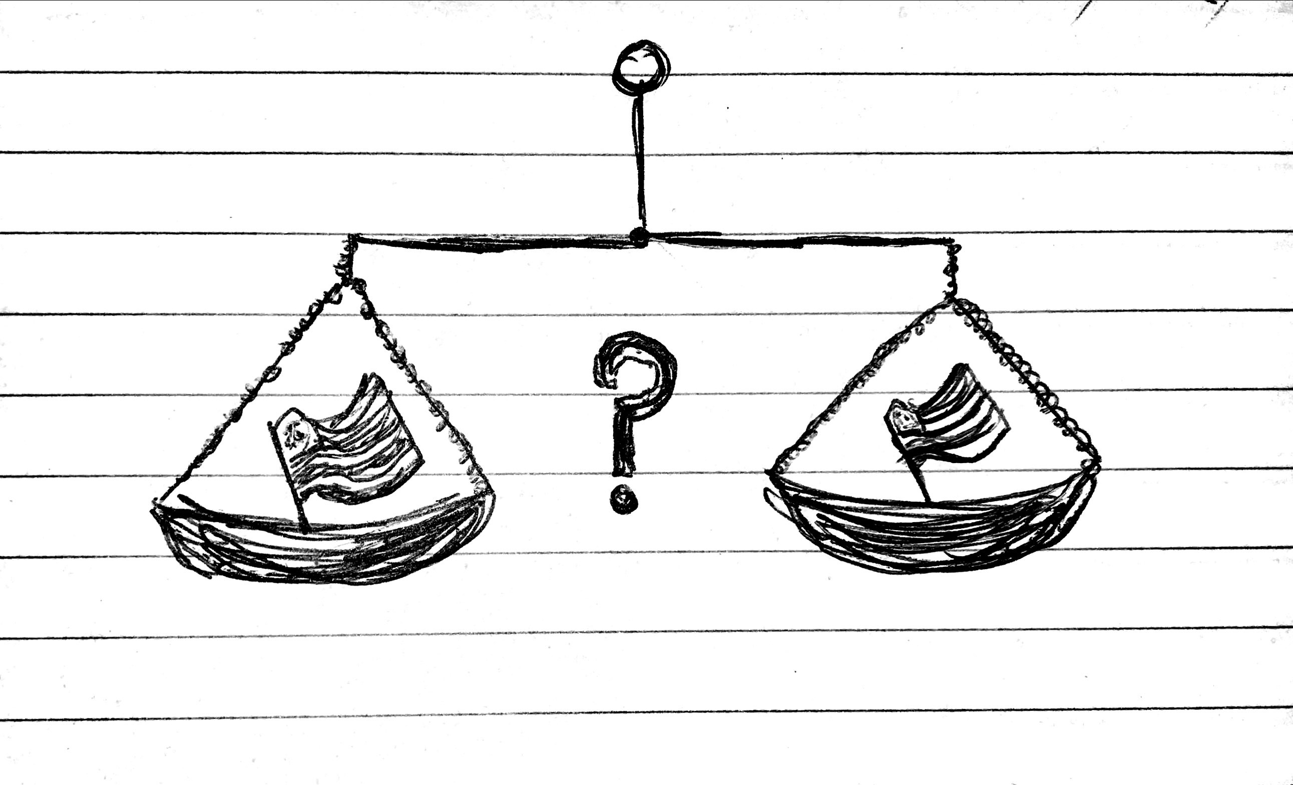
This is a draft – come to the talk for the details

Slide 5
This is a draft – come to the talk for the details

Slide 6
The problem
How many kids?
Where are they?
What is their status?
What is their fate?

Slide 7
What we’ve been doing…
Trying to get the facts
Striving to have a voice
Searching for paths to offer help

Slide 8
5 Vignettes
The Flores Case: rights
ORR: DHS vs. HHS
Lawsuits: our role in the legal system
UNCRC: Congressional power
A girl from Mexico: Trauma Informed Responsive Care and Self Care

Slide 9
Who do you want to be?
Ethics
Rights
Values & Virtues

Slide 10
What you can do
Learn to do asylum assessments
Call your congressional representative, and keep calling
Cultivate trauma informed responsive caregiving and .. self care

Slide 11
The message
When these kids hurt, it hurts us all

Slide 12
The bottom line: take 1
Commander Taggert’s line

Slide 13
The bottom line: take 2
The US Holocaust Museum’s tag line

Slide 14
Resources
AACAP RGYB and D&T Webpages
NCTSN.org

