Slide 1
Family Separation and Reunification from the Perspectives of Adult Family Members of the “Disappeared” Children of El Salvador
Elizabeth Barnert MD, MPH, MS
Department of Pediatrics, UCLA

Slide 2
I have no conflicts of interest to disclose.

Slide 3
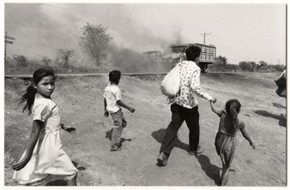
Background
Civil war (1980-1992)
Disappeared children
Prior study:
Analyzed the family separation and reunification process of 26 individuals (ages 24-34) who underwent separation as children and reunification as adolescents
Found that the process could be categorized into 6 phases
Notes:
Civil war: resulted in thousands of civilian deaths, the destruction of entire villages, and the forced separation of thousands of children from their families
Disappeared children: missing or abducted children during the war. Many of these children were placed in “Residential Institutions” (orphanages), placed in legal or de facto adoption. Fostering or Appropriation. Instances of child trafficking. Some grew up in a military base—introduce story of Mauricio and Amilcar.
1994 families of the missing children founded the NGO Asociacion Pro-Busqueda de Niñas y Niños Desaparecidos (Association for the search of disappeared children). Through this organization, the lead author of the Prior Study was able to do field work.
Prior study conducted between 2005-2009 in El Salvador. Focused on “identifying themes representative of the disappeared youths’ experiences with family separation and reunification.”

Slide 4
6 Phases of Reunification
Pre-disappearance
Disappearance
Separation
Searching
Reunion
Reunification
Notes:
Pre-Disappearance: period before being separated. Usually highlights memories of a happier time as well as struggling through the war
Disappearance: circumstances, the event, ripped away from family. Military raids, military forcibly taking away, parents placing children in orphanages to dedicate themselves to guerrilla, inability to care for child due to poverty
Separation: the long term period of being separated. At this stage, “the youth has reached a relatively stable living arrangement” away from their biological parents or family (adoption, orphanage) Some faced continued separation—moving among several settings.
Searching: Refers to “the desire to find’s one relatives or at least a willingness to be found”. Can be described as a turning point—away from separation toward reunion.
Reunion: Festive atmosphere, emotional, challenging . “mirrors the disappearance in the sense that youth were thrust out of the family structures that they had created during the separation period”
Reunification: long-term process, usually ongoing. Building a new family structure, reconstructing sense of identity

Slide 5
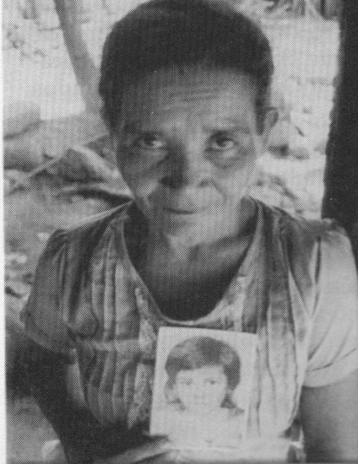
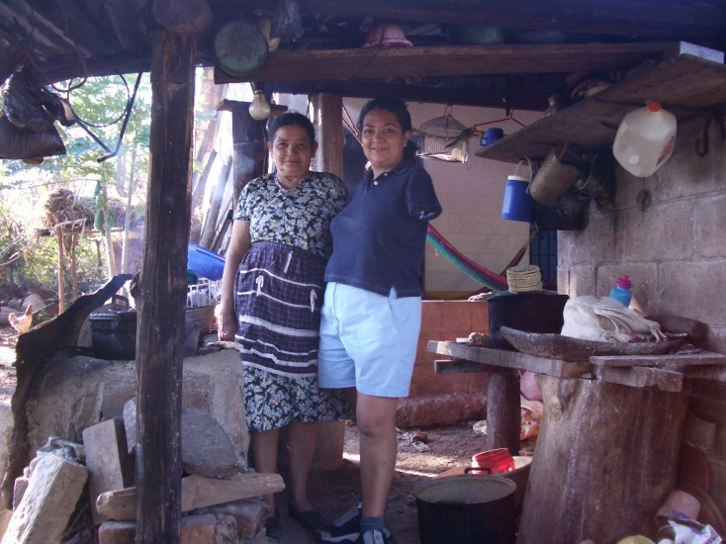
Objective
To explore the process of family separation and reunification from the perspectives of adult family members of “disappeared” children

Slide 6
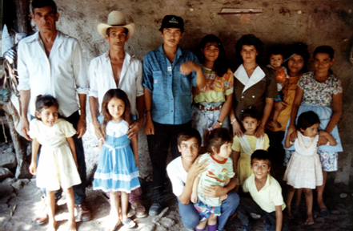
Methods
Semi-structured interviews
Conducted in El Salvador
Participants: biological family members (n=16) of the youth participants from our previous study and the youths’ adoptive family members (n=4)
Notes:
We went back to the interviews! This time we focused on analyzing the interviews of relatives, this included mom, dads, grandparents, aunts, and uncles.

Slide 7
Methods
Two-staged thematic analysis
Coded interview transcripts using the 6 phases of separation and reunification
Coded interview transcripts with 4 emergent codes
Resiliency
Faith
Hopefulness vs. Despair
Peace of Mind (“Tranquilidad”)
Notes:
After reading and coding all interviews with the original 6 phases, we found 4 emergent codes that cut across interviews.
Resiliency: both in terms of surviving the war and in their search for their missing children
Faith: invocation of God, faith in finding their children
Hopefulness vs. Despair: game of tug-a-war. Emotions altered in some, while others had one.
Peace of Mind: Usually achieved after reunion. Closure to that “ambiguous loss”

Slide 8
Results
Circumstances of a child’s disappearance influenced biological family’s pathway through the 6 phases
Separation during raids
Giving up the child
Parents’ military involvement
Poverty/Adoption
Notes:
Plan: go over the phases in each scenario; highlight differences and similarities

Slide 9
Reunion and Reunification
Reunion event elicited joy and closure, but reunification was extremely challenging
Adult relatives struggled to gain trust, acceptance, and recognition from their “disappeared” child
Acceptance from the adoptive families eased reunification, though many adoptive relatives feared losing their adoptive children

Slide 10
Limitations
Recall bias
Sample size
Adoptive Parents
Limited generalizability
Notes:
Recall bias: memories of pre-war, war, and reunion; asked to recall traumatic experiences and events that happened years prior
Sample size: small, and also selected from one org. Did not include outside cases, like those in the US
Generalizability: Research happened in the 80’s and the sample was from families connected to Pro-Busqueda in El Salvador. Extreme example.

Slide 11
Conclusion
For family members of the disappeared, separation and reunification was a challenging, painful, long-term process
Whenever possible, prevention of family separation is warranted
Continued psycho-social supports during separation and reunification may enhance family members’ well-being

Slide 12
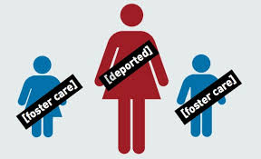
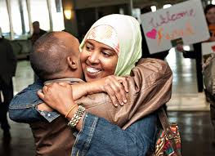
Application
Separation of children from their biological parents through:
Immigration
Incarceration
Foster Care
War
Notes:
Comment on each

Slide 13
Acknowledgements
Co-authors: Nathalie Lopez BS; Philippe Bourgous PhD; Gery Ryan, PhD; Paul Chung, MD, MS; Eric Stover, MA
Asociación Pro-Búsqueda
UC Berkley Human Rights Center
UCLA Children’s Discovery and Innovation Institute (CDI)
Contact: ebarnert@ucla.mednet.edu
Notes:
As of 2/8, there has now been 435 solved cases

Slide 14
Thank You

