Slide 1
Aggression & Bullying in 2020: Youth experience & clinical treatment considerations
Presented by Susan Writer, Ph.D.

Slide 2
Objectives & Goals
Identify the sociological, cultural, physiological, and psychological issues pertinent to teenagers and transitional age youth who are most at risk for aggression and/or bullying.
Define the types of bullying inclusive of the cycle of bullying and the bullying ecosystem.
Examine the effects of “going cyber” with regard to bullying and aggression as they pertain to anonymity and privacy, access, and contagion.
Discuss the clinical implications of bullying: clinical assessment, the role of trauma, psychoeducation, communication skills, and empowerment.

Slide 3
Context, definitions,& considerations

Slide 4
Context
According to the Centers for Disease Control (CDC):
Bullying is common. 1 in 5 high school students reported being bullied on school property in the last year.
Bullying is frequent. Bullying is among the most commonly reported discipline problems in public schools. Nearly 14% of public schools report that bullying happens at least once a week. Reports of bullying are highest for middle schools (28%) followed by high schools (16%), combined schools (12%), and primary schools (9%).
Bullying can happen online. Reports of cyberbullying among public school attending students are highest for middle school (33%), followed by high school (30%), combined schools (20%) and primary schools (5%).
Source: Centers for Disease Control and Prevention (2019). Preventing Bullying Factsheet. Retrieved from: https://www.cdc.gov/violenceprevention/youthviolence/bullyingresearch/fastfact.html

Slide 5
Defining Aggression
The American Psychological Association defines aggression as:
“…n. behavior aimed at harming others physically or psychologically. It can be distinguished from anger in that anger is oriented at overcoming the target but not necessarily through harm or destruction.”
There are many different types of human aggression:
Source: American Psychological Association. (2018). APA Dictionary of Psychology: Aggression. Retrieved from: https://dictionary.apa.org/aggression
Source: Smith, K. (2020), Hostile-Aggressive Behavior...preventing and dealing with challenging behavior. The Institute on Community Integration, College of Education, University of Minnesota. Retrieved from: https://ceed.umn.edu/tip-sheets/
Source: University of Minnesota Libraries Publishing. (2015). Principles of Social Psychology. Minneapolis, MN : University of Minnesota Libraries Publishing, Minneapolis : Open Textbook Library
Hostile
Instrumental
Affective
Proactive
Reactive
Displaced
Pathological
Physical (Direct)
Verbal (Indirect)
Vandalism
Planned or Cognitive
Emotional or Impulsive

Slide 6
Bullying
“…Bullying is any unwanted aggressive behavior(s) by another youth or group of youths that involves an observed or perceived power imbalance and is repeated multiple times or is highly likely to be repeated. Bullying may inflict harm or distress on the targeted youth including physical, psychological, social, or educational harm.”
Source: Centers for Disease Control and Prevention. (2014). Bullying Surveillance Among Youths Uniform Definitions For Public Health And Recommended Data Elements. Retrieved from: www.cdc.gov/violenceprevention/pdf/bullying-definitions-final-a.pdf

Slide 7
Aggressive Behaviors Within Bullying
“…Aggressive behavior is the intentional use of harmful behavior(s), threatened or actual, against another youth. Instead of attempting to assess whether the perpetrator intended for the victim to experience an injury as a result of the bullying behavior, intentionality can be captured by assessing the perpetrator’s intent to use harmful behaviors against the targeted youth. For instance, telling damaging rumors about a youth, threatening another youth, or shoving another youth would be considered intentional because the perpetrator is using harmful behaviors against another youth. This approach to measuring intentionality is consistent with how the CDC and the World Health Organization measure other types of violence (Dahlberg & Krug, 2002).”
Source: Centers for Disease Control and Prevention. (2014). Bullying Surveillance Among Youths Uniform Definitions For Public Health And Recommended Data Elements. Retrieved from: www.cdc.gov/violenceprevention/pdf/bullying-definitions-final-a.pdf

Slide 8
Modes & Types of Bullying
Modes
Direct
Indirect
Types
Physical
Verbal
Relational
Property Damage
Source: Gladden, Vivolo-Kantor, Hamburger, and Lumpkin (2014). Bullying Surveillance Among Youths Uniform Definitions For Public Health And Recommended Data Elements. www.cdc.gov/violenceprevention/pdf/bullying-definitions-final-a.pdf compiled, retrieved February 2020.

Slide 9
Direct Versus Indirect Bullying
Modes of Bullying
“Direct: aggressive behavior(s) that occur in the presence of the targeted youth.
Examples of direct aggression include but are not limited to face-to-face interaction, such as pushing the targeted youth or directing harmful written or verbal communication at a youth.
Indirect: aggressive behavior(s) that are not directly communicated to the targeted youth.
Examples of indirect aggression include but are not limited to spreading false and/or harmful rumors or communicating harmful rumors electronically.”
Source: Gladden, Vivolo-Kantor, Hamburger, and Lumpkin (2014). Bullying Surveillance Among Youths Uniform Definitions For Public Health And Recommended Data Elements. www.cdc.gov/violenceprevention/pdf/bullying-definitions-final-a.pdf compiled, retrieved February 2020.

Slide 10
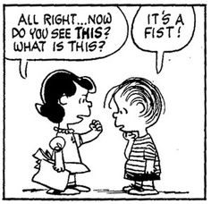
Physical bullying
“…The use of physical force by the perpetrator against the targeted youth. Examples include but are not limited to behaviors such as hitting, kicking, punching, spitting, tripping, and pushing.”
Source: Gladden, Vivolo-Kantor, Hamburger, and Lumpkin (2014). Bullying Surveillance Among Youths Uniform Definitions For Public Health And Recommended Data Elements. www.cdc.gov/violenceprevention/pdf/bullying-definitions-final-a.pdf compiled, retrieved February 2020.

Slide 11
Verbal Bullying
“…Oral or written communication by the perpetrator against the targeted youth that causes him or her harm. Examples include but are not limited to mean taunting, calling the youth names, threatening or offensive written notes or hand gestures, inappropriate sexual comments, or threatening the youth verbally.”

Slide 12
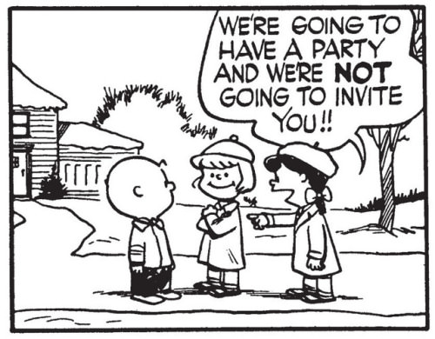
Relational Bullying
“…Behaviors by a perpetrator designed to harm the reputation and relationships of the targeted youth. Direct relational bullying includes but is not limited to efforts to isolate the targeted youth by keeping him or her from interacting with their peers or ignoring them. Indirect relational bullying includes but is not limited to spreading false and/or harmful rumors, publicly writing derogatory comments, or posting embarrassing images in a physical or electronic space without the target youth’s permission or knowledge”
Source: Gladden, Vivolo-Kantor, Hamburger, and Lumpkin (2014). Bullying Surveillance Among Youths Uniform Definitions For Public Health And Recommended Data Elements. www.cdc.gov/violenceprevention/pdf/bullying-definitions-final-a.pdf compiled, retrieved February 2020.

Slide 13
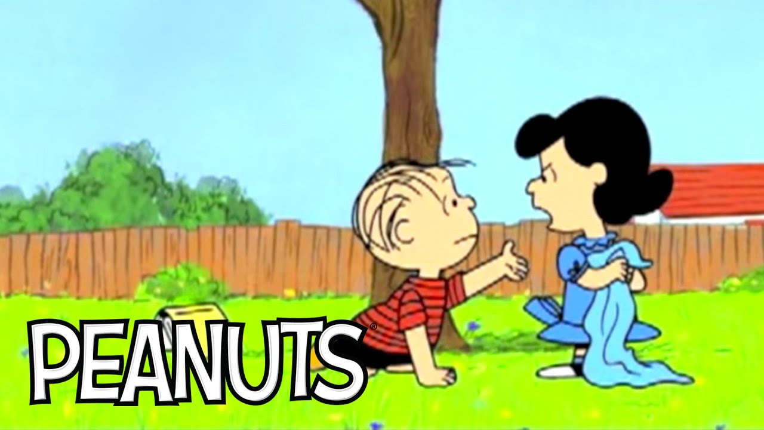
Property Damage as Bullying
“…Theft, alteration or damaging of the target youth’s property by the perpetrator to cause harm. These behaviors can include but are not limited to taking a youth’s personal property and refusing to give it back, destroying a youth’s property in their presence, or deleting personal electronic information.”

Slide 14
Harassment
“…Harassment, unlike bullying, does not have to include intent by the perpetrator to harm, be directed at a specific person or involve repeated incidents. Harassment is defined as threatening, harmful or humiliating conduct based on race, color, national origin, sex or disability. Harassment may result in a hostile environment that interferes or limits a student’s ability to participate in or benefit from the services, activities or opportunities offered by a school.⁵ Schools may also include religion, sexual orientation, gender identity, gender expression and other actual or perceived characteristics of students who may have increased risk in their harassment and bullying prevention policies.”
Source: American Psychological Association. (2020). Bullying, Harassment and Electronic Aggression Prevention. Retrieved from: https://www.apa.org/pi/lgbt/programs/safe-supportive/bullying/index
Source: U.S. Department of Education. (2012). Dear Colleague Letter: Harassment and Bullying. U.S. Department of Education Web site. Retrieved from: http://www2.ed.gov/about/offices/list/ocr/letters/colleague-201010.pdf (PDF, 96.93KB)

Slide 15
Relationship and interpersonal violence
“…The current uniform definition of bullying excludes sibling violence and violence that occurs within the context of an intimate or dating relationship. The different forms of violence (e.g., sibling violence, teen dating violence, intimate partner violence) can include aggression that is physical, sexual, or psychological (e.g., verbal, belittling, isolating, coercive). However, the context and uniquely dynamic nature of the relationship between the victim and the perpetrator in which these acts occur is different from that of peer violence (Heise & Garcia-Moreno, 2002). Consequently, it is important to assess teen dating violence and sibling violence separately from bullying in order to establish separate prevalence estimates and to understand the patterns and dynamics involved. The CDC defines teen dating violence as “the physical, sexual, or psychological/emotional violence within a dating relationship, as well as stalking” (Centers for Disease Control and Prevention, 2012)”
Source: Centers for Disease Control and Prevention. (2014). Bullying Surveillance Among Youths Uniform Definitions For Public Health And Recommended Data Elements. Retrieved from: www.cdc.gov/violenceprevention/pdf/bullying-definitions-final-a.pdf

Slide 16
Bullying Dynamics, Frameworks, & Models

Slide 17
Bullying ecosystem
Bully
Crew
Witness
Confidant
Defender
Victim
Identification with the aggressor –
from victim to bully

Slide 18
Types of aggressors & Bullies
Children/Adolescents
Known (Peer)
Anonymous
Adults/Older Adults
Familial
Stranger

Slide 19
Sociological & Cultural influences
An existing power imbalance is a fundamental socio-cultural risk factor bullying. It can take many forms, for example:
Physiological characteristics
Age
Size
Strength
Illness, disability, or special need
Ethnic or racial characteristics
Popularity or perceived influence
Abilities and skills
Academic
Athleticism
Artistic
Sex, gender identity, and sexual orientation
Religion
Political affiliation
Socio-economic status
Housing and food security
Financial stability
Access to resources or influence
Any minority-majority group affiliation differences
Any perceived difference from the “norm”
Foster children, non-native children, indigenous youth, military families

Slide 20
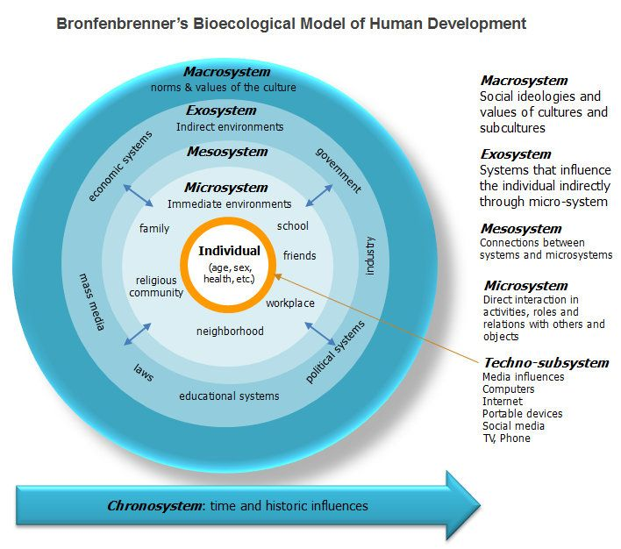
Social-Ecological Framework
Bullying is:
A complex form of interpersonal aggression
Rooted in a social context
It takes multiple forms
It serves many functions
Source: Swearer, S. S., & Hymel, S. (2015). Understanding the psychology of bullying: Moving toward a social-ecological diathesis-stress model. American Psychologist, 70(4), 344-353.

Slide 21
Diathesis-Stress Model
“…Diathesis–stress models propose that psychopathology occurs as the result of the combination of individual cognitive or biological vulnerabilities (i.e., diatheses) and certain environmental stressors (Cicchetti & Toth, 1998; Lazarus, 1993). Further, these models posit that both negative life events and one’s cognitions about those events contribute to the development of internalizing and externalizing psychopathology.”
Source: Swearer, S. S., & Hymel, S. (2015). Understanding the psychology of bullying: Moving toward a social-ecological diathesis-stress model. American Psychologist, 70(4), 344-353.

Slide 22
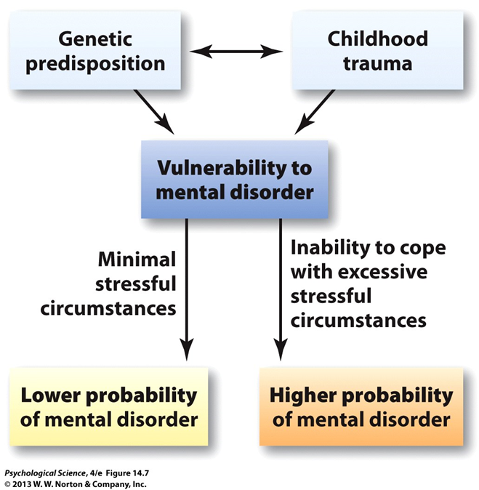

Slide 23
Diathesis Stress Model & Bullying
“…According to diathesis–stress models…bullying is conceptualized as a stressful life event, influenced by multiple social stressors…the presence of social stressors does not fully explain the development of psychological difficulties…stressful life events can be exacerbated by biological vulnerabilities and can activate cognitive vulnerabilities, leading to more significant, negative outcomes.”
Source: Swearer, S. S., & Hymel, S. (2015). Understanding the psychology of bullying: Moving toward a social-ecological diathesis-stress model. American Psychologist, 70(4), 344-353.

Slide 24
A Plethora of Lenses
We can understand the underpinnings and dynamics of bullying through multiple theoretical frameworks:
Object Relations
Social Comparison
Attachment
Behavioral Social Learning
Archetypes
Cognitive Structures
Attunement
Personality Typology
Locus of Control
And many, many others…

Slide 25
Bullying & Functioning

Slide 26
Physiological & Psychological Functioning: Bullies
“…The typical bully is one who exhibits significant externalizing behavior, has internalizing symptoms, has both social competence and academic challenges, possesses negative attitudes and beliefs about others, has negative self-related cognitions, has trouble resolving problems with others, comes from a family environment characterized by conflict and poor parental monitoring, is more likely to perceive his or her school as having a negative atmosphere, is influenced by negative community factors, and tends to be negatively influenced by his or her peers.”
Cook, C. R., Williams, K. R., Guerra, N. G., Kim, T. E., & Sadek, S. (2010). Predictors of bullying and victimization in childhood and adolescence: A meta-analytic investigation. School Psychology Quarterly, 25(2), 65–83. https://doi.org/10.1037/a0020149

Slide 27
Correlates in Bullies
Bullies are often associated with:
Antisocial personality traits
Lack of empathy/callousness/lack of emotionality
Psychopathic tendencies
Hyper-masculinity
Susceptibility to peer pressure
Anxiety and/or depression
Conduct problems
Can be categorized into:
Socially integrated
Socially marginalized
Source: Swearer, S. S., & Hymel, S. (2015). Understanding the psychology of bullying: Moving toward a social-ecological diathesis-stress model. American Psychologist, 70(4), 344-353.

Slide 28
Physiological & Psychological Functioning: Victims
“…The typical victim is one who is likely to demonstrate internalizing symptoms; engage in externalizing behavior; lack adequate social skills; possess negative self-related cognitions; experience difficulties in solving social problems; come from negative community, family, and school environments; and be noticeably rejected and isolated by peers.”
Source: Cook, C. R., Williams, K. R., Guerra, N. G., Kim, T. E., & Sadek, S. (2010). Predictors of bullying and victimization in childhood and adolescence: A meta-analytic investigation. School Psychology Quarterly, 25(2), 65–83. https://doi.org/10.1037/a0020149

Slide 29
Correlates in Victims
Victims are often associated with:
Poor social and school adjustment
Delinquency and aggression
Feeling unsafe and unhappy
Truancy and school dropout
Rejection by peers
Less well-liked by peers
Poor physical health
Loneliness and withdrawal
Suicidality
Anxiety and social avoidance
Source: Cook, C. R., Williams, K. R., Guerra, N. G., Kim, T. E., & Sadek, S. (2010). Predictors of bullying and victimization in childhood and adolescence: A meta-analytic investigation. School Psychology Quarterly, 25(2), 65–83. https://doi.org/10.1037/a0020149

Slide 30
Physiological & Psychological Functioning: Bully Victims
“…The typical bully victim is one who has comorbid externalizing and internalizing problems, holds significantly negative attitudes and beliefs about himself or herself and others, is low in social competence, does not have adequate social problem-solving skills, performs poorly academically, and is not only rejected and isolated by peers but also negatively influenced by the peers with whom he or she interacts.”
Cook, C. R., Williams, K. R., Guerra, N. G., Kim, T. E., & Sadek, S. (2010). Predictors of bullying and victimization in childhood and adolescence: A meta-analytic investigation. School Psychology Quarterly, 25(2), 65–83. https://doi.org/10.1037/a0020149

Slide 31
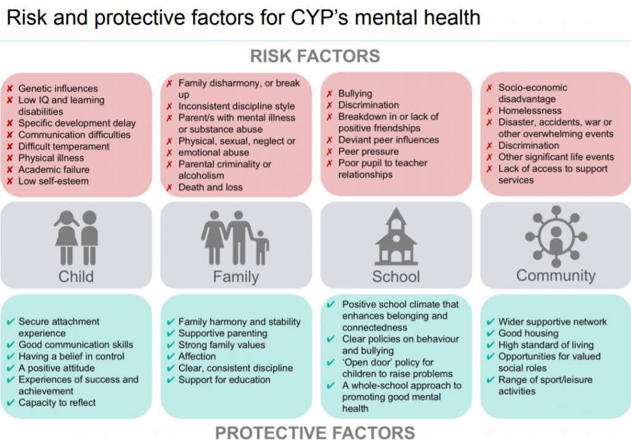
Source: Emotionally Healthy Schools (2019). Retrieved from: https://emotionallyhealthyschools.org/risk-factors/risk-and-protective-factors/

Slide 32
Proximal Social Support
Parental, familial and extended family
School teachers and coaches
Community and faith leaders
Peers

Slide 33
Non-Proximal Social Support
Internet
Social Networks

Slide 34
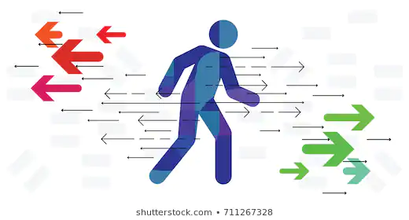
Transient Social Support
Military families
Foster children
Divorce
School transitions
Loss

Slide 35
Not a Harmless Rite of Passage: Bullying over time from youth to adulthood
Victims (only)
“…had elevated rates of anxiety disorders, things like agoraphobia, panic disorder, and generalized anxiety”
Bully Victims
“…seemed to be the worst off. They had about five times higher risk of depression and five times higher risk of suicidal thoughts and behavior, as well as risks for some anxiety disorders too. ”
Bullies (only)
“…did not have any kind of emotional problems in adulthood but they did still have some behavioral problems, suggesting that they might still be engaging in some kind of bullying—perhaps at work or home or elsewhere”
Source: National Institute of Mental Health (2013). Bullying Exerts Psychiatric Effects Into Adulthood. Retrieved from: https://www.nimh.nih.gov/news/media/2013/bullying-exerts-psychiatric-effects-into-adulthood.shtml

Slide 36
Advances in Bullying & Aggression: Cyber-bullying

Slide 37
Debate over Cyberbullying definition
Do traditional definitions and criteria of bullying apply to cyberspace?
Does there have to be repeated instances to define an aggressive cyber act as cyberbullying?
Doesn’t an inherent power differential exist because the perpetrator is by default the aggressor on the “offensive”, putting the target on the defensive in a more vulnerable position?
What are the differences in the effects of direct (peer-to-peer – e.g., texting) attacks versus indirect public (e.g., tweeting) attacks in cyber space?
Would cyberaggression, cybervictimization, or cyberabuse be more appropriate terms?
Source: Corcoran, L., McGuckin, C., and Prentice, G. (2015). Cyberbullying or Cyber Aggression?: A review of existing definitions of cyber-based peer-to-peer aggression. Societies (5), 245-255.
Source: van Geel, M., Vedder, P., Tanilon, J. (2014). Relationship Between Peer Victimization, Cyberbullying, and Suicide in Children and Adolescents. JAMA Pediatrics, (5), 435-442.

Slide 38
Cyberbullying
“…bullying, n. persistent threatening and aggressive physical behavior or verbal abuse directed toward other people, especially those who are younger, smaller, weaker, or in some other situation of relative disadvantage. Cyberbullying is verbally threatening or harassing behavior conducted through such electronic technology as cell phones, e-mail, and text messaging.”
Source: American Psychological Association. (2018). APA Dictionary of Psychology: Bullying. Retrieved from: https://dictionary.apa.org/bullying

Slide 39
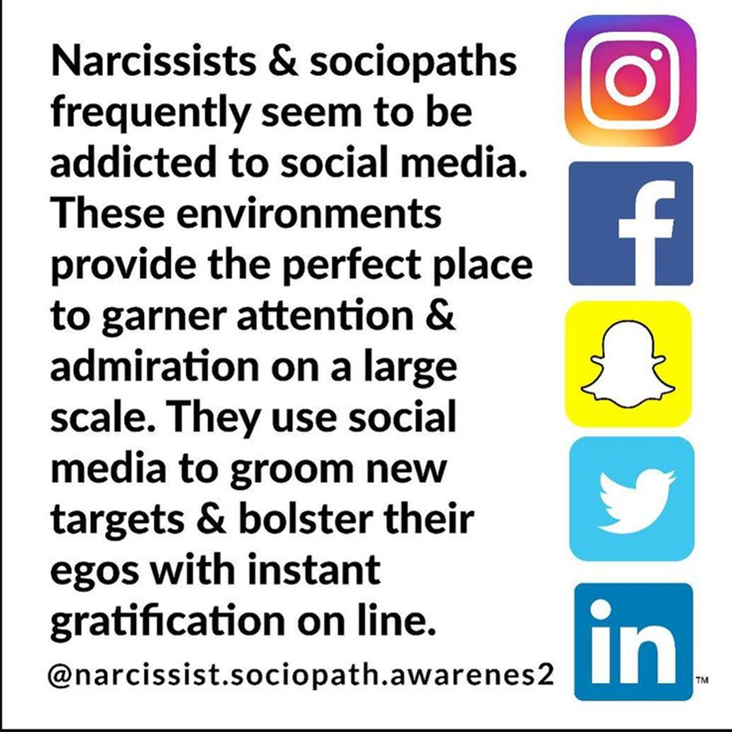
Types of Cyber Aggression & Bullying
Email & text
Social Media & Social Networks
YouTube
Snap Chat
Instagram
WhatsApp
Kik
Telegram
Twitter
Facebook???
What about bullies?

Slide 40
Advantages of Going Digital
Anonymity and privacy
About 30% of victims do not know the identity of the cyberbully*
Can lead to increased severity and intensity of attacks
Lack of having to see the effects first-hand can lead to decreased (or loss of) empathy and remorse
24-hour access
Targets can’t escape and have no “safe place”
Increased anxiety among those targeted
Increased frequency and intensity
Mob effect and contagion
Ability to spread negativity to masses quickly and easily
Magnifies and amplified aggression and the target
Schadenfreude
*Source: Waasdrop, TE, and Bradshaw, CP (2015). The Overlap Between Cyberbullying and Traditional Bullying. Journal of Adolescent Health (56) 483-488

Slide 41
Cyberbullying
In-person bullying is still more prevalent than cyberbullying; but cyberbullying is more common among children, adolescents, and transitional age youth than adults
Girls are more likely than boys to cyberbully
The majority of children/adolescents who cyberbully are also bullied in person; only 4.6% of youth report that they are only cyberbullied*
Parental controls
Social role models
Politics
Sports
Entertainment and celebrity
Social comparison
Demoralization
Self-objectification to unrealistic standard
Celebrity status
*Source: Waasdrop, TE, and Bradshaw, CP (2015). The Overlap Between Cyberbullying and Traditional Bullying. Journal of Adolescent Health (56) 483-488

Slide 42
Clinical & Research implications

Slide 43
Bullying & the Brain
“…Middle adolescence is characterized by a combination of heightened reward sensitivity and sensation-seeking, attunement to the peer group, and underdeveloped impulse control…In addition to this emotion-control imbalance, adolescents are highly attuned to the social group…Adolescents’ unique sensitivity toward social rewards makes peer admiration and approval a particularly desirable goal. The developmental literature recognizes bullying behavior as being both goal-directed and associated with social benefits that can serve to sustain the behavior despite costs…these findings suggest that current legislation and policy regarding bullying may be missing the mark. Overly harsh and punitive approaches focus on increasing the costs of bullying without equivalent attention to the potential rewards that may be sustaining these strategies…”
Source: Swearer, Susan M.; Martin, Meredith; Brackett, Marc; and Palacios, Raul A. II, "Bullying Intervention in Adolescence: The Intersection of Legislation, Policies, and Behavioral Change" (2016). Educational Psychology Papers and Publications. 213.

Slide 44
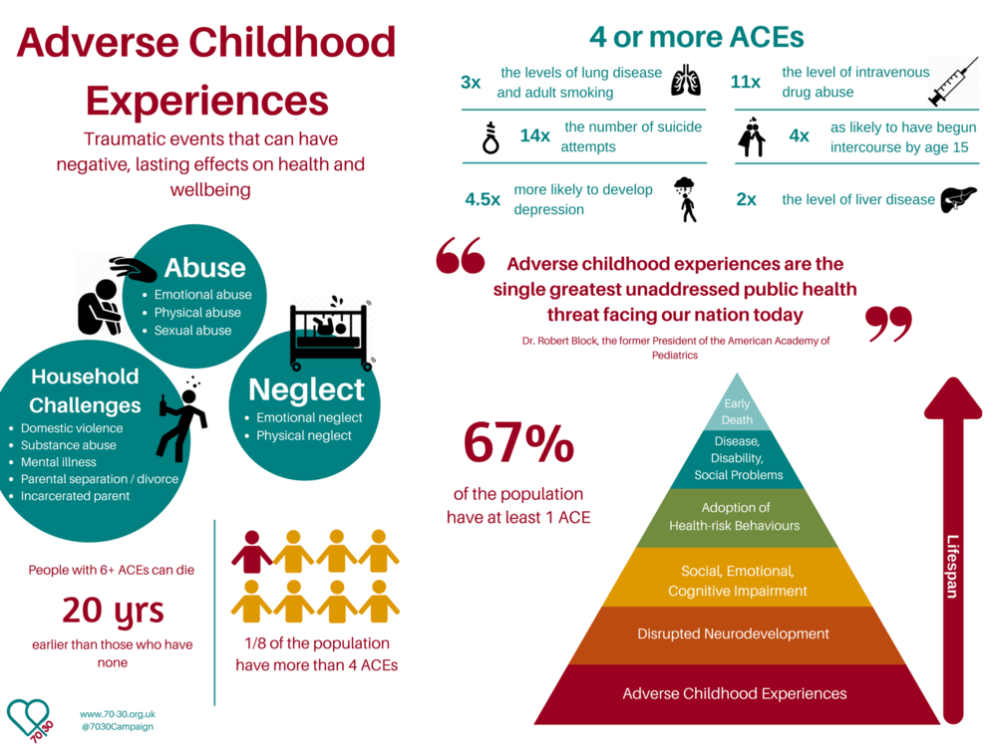
Bullying, Trauma & Physical Health

Slide 45
Bullying, Trauma & Psychiatric Comorbidities
Suicide
Self-injury
Mood and anxiety disorders
OCD and hoarding
Eating disorders and body dysmorphia
Personality disorders
Substance use disorders

Slide 46
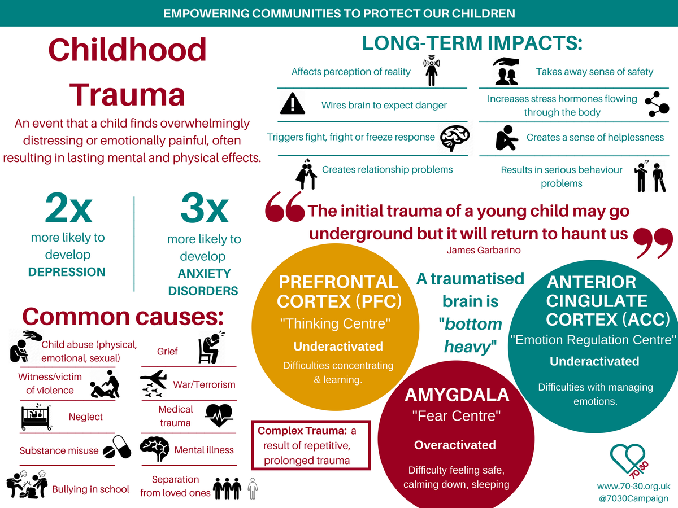
Bullying, Trauma & Mental Health

Slide 47
Research Domains
Through their Research Domain Criteria Initiative, the National Institute of Mental Health has established suggested elements of study for the paradigms, relational & physical aggression (handout)
Domains:
Negative Valence Systems
Positive Valence Systems
Cognitive Systems
Social Processes
Arousal/Regulatory Systems
Sensorimotor Systems
Source: https://www.nimh.nih.gov/research/research-funded-by-nimh/rdoc/units/paradigms/151078.shtml

Slide 48
Evidence-Based Approaches
The majority of the research on bullying has been in the field of school psychology and creating policy and legislative efforts to reduce bullying on school campuses
Thus, the majority of the evidence-based treatments align more with the psychological functioning and development of psychopathology than with “bullying” per se
School-based interventions that are evidence-based include principles of Positive Psychology and positive reinforcement behavioral strategies with a strong psychoeducational component, through the lens of trauma-informed practices
Individual and family-based clinical interventions address the underlying psychopathology associated with bullying ecosystems as they are understood through different theoretical frameworks, lenses, and approaches
Source: Swearer, S.M., Martin, M., Brackett, M., and Palacios II, R.A. (2016). Bullying Intervention in Adolescence: The intersection of legislation, policies, and behavioral change. Educational Psychology Papers and Publications, 213.

Slide 49
Treatment: Victims
Victim
Survivor
Thriver
Protective factors and resilience
Empowerment and assertiveness
Self-efficacy and locus of control
Self-esteem
The role of shame and blame
Movement from victim to survivor
Psychiatric issues
Substance abuse issues
Support networks

Slide 50
Treatment: Bullies
Develop Attunement
Increase Empathy
Process Shame
Empower Change
Therapist considerations
Comfort
Expertise
Forensic concerns
Reporting
Rehabilitation options
Evidence based practices
Psychiatric issues
Substance abuse issues
Self-esteem
Non-violent communication
Redefining relationships

Slide 51
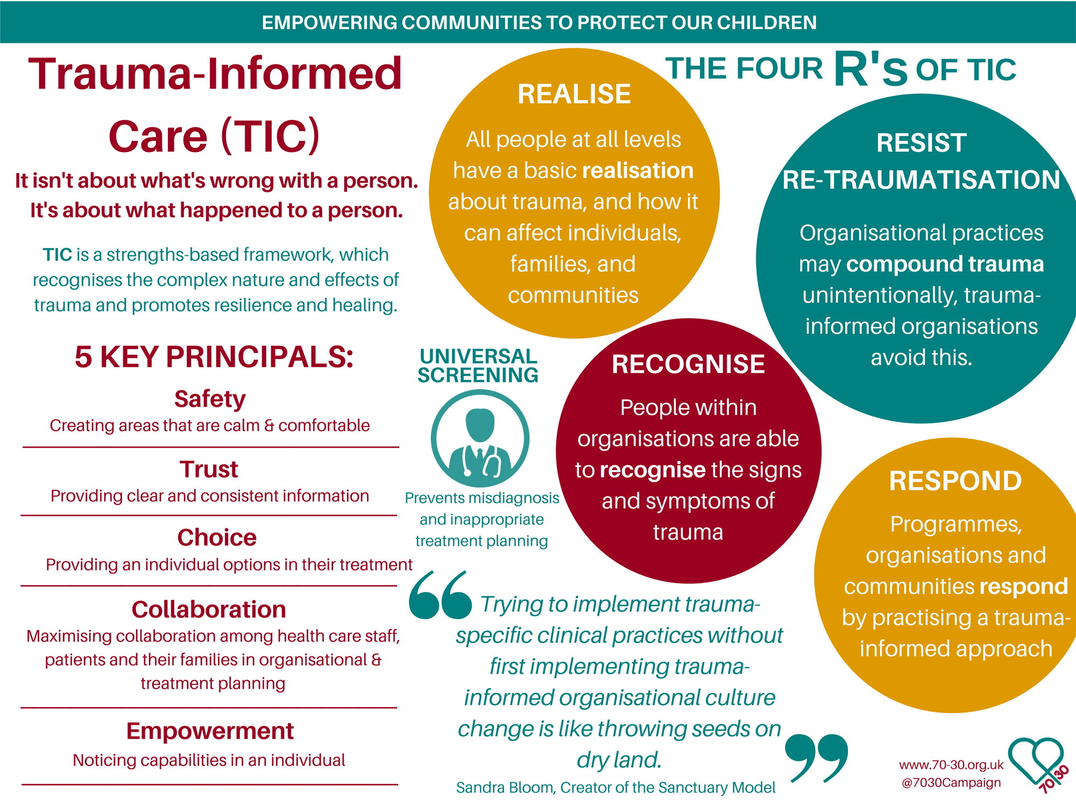
Community & Family Awareness

Slide 52
Psychoeducation
Role of therapist
Role of parent
Role of school
Role of community

Slide 53
RESPONSIVITY VERSUS REACTIVITY
Reaction
Response
Invalidating
Unconscious
Impetuous/emotionally loaded
Spontaneously blurted
Perpetuates a monologue
Problem driven
Diffuse
Unilateral
Validating
Conscious
Rational/thoughtfully considered
Intentionally delivered
Opens a dialogue
Solution focused
Strategic
Collaborative

Slide 54
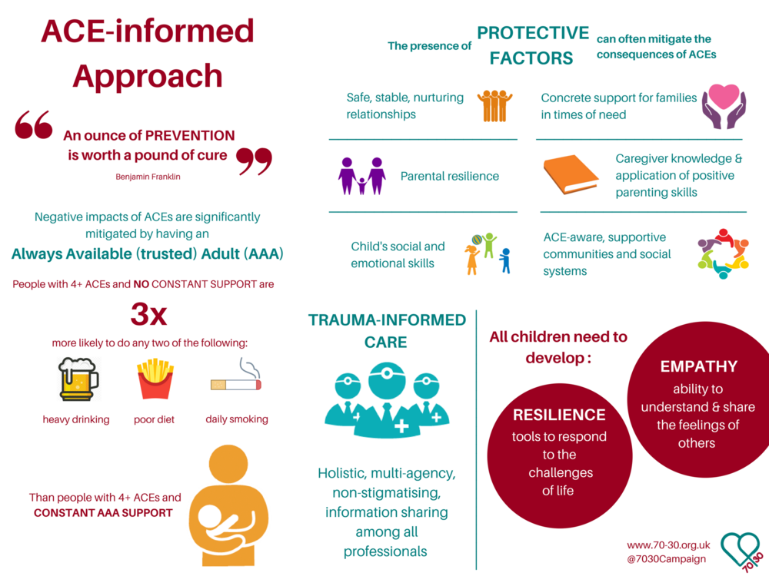
Targeted Skill Development

Slide 55
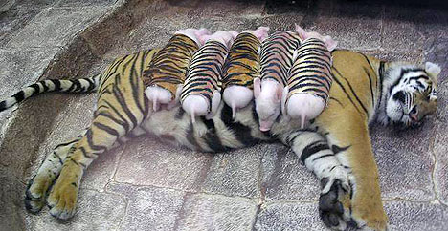
The Power of Face-to-Face Communication: *HUGS*

Slide 56
Bullying doesn’t happen in a vacuum
It takes a village….

Slide 57
References
American Psychological Association. (2020). Bullying, Harassment and Electronic Aggression Prevention. Retrieved from: https://www.apa.org/pi/lgbt/programs/safe-supportive/bullying/index
American Psychological Association. (2018). APA Dictionary of Psychology: Aggression. Retrieved from: https://dictionary.apa.org/aggression
American Psychological Association. (2018). APA Dictionary of Psychology: Bullying. Retrieved from: https://dictionary.apa.org/bullying
Centers for Disease Control and Prevention (2019). Preventing Bullying Factsheet. Retrieved from: https://www.cdc.gov/violenceprevention/youthviolence/bullyingresearch/fastfact.html
Centers for Disease Control and Prevention. (2014). Bullying Surveillance Among Youths Uniform Definitions For Public Health And Recommended Data Elements.
Cook, C. R., Williams, K. R., Guerra, N. G., Kim, T. E., & Sadek, S. (2010). Predictors of bullying and victimization in childhood and adolescence: A meta-analytic investigation. School Psychology Quarterly, 25(2), 65–83. https://doi.org/10.1037/a0020149
Corcoran, L., McGuckin, C., and Prentice, G. (2015). Cyberbullying or Cyber Aggression?: A review of existing definitions of cyber-based peer-to-peer aggression. Societies (5), 245-255.
Emotionally Healthy Schools (2019). Retrieved from: https://emotionallyhealthyschools.org/risk-factors/risk-and-protective-factors/
Gazzaniga, M. , Heatherton, T., Halpern, D. (2013). Psychological Science. New York: W.W. Norton Company, Inc.
Gladden, Vivolo-Kantor, Hamburger, and Lumpkin (2014). Bullying Surveillance Among Youths Uniform Definitions For Public Health And Recommended Data Elements. www.cdc.gov/violenceprevention/pdf/bullying-definitions-final-a.pdf compiled, retrieved February 2020.
National Institute of Mental Health (2013). Bullying Exerts Psychiatric Effects Into Adulthood. Retrieved from: https://www.nimh.nih.gov/news/media/2013/bullying-exerts-psychiatric-effects-into-adulthood.shtml

Slide 58
References
National Institute of Mental Health. Research Domain Criteria Initiative. https://www.nimh.nih.gov/research/research-funded-by-nimh/rdoc/units/paradigms/151078.shtml
Smith, K. (2020), Hostile-Aggressive Behavior...preventing and dealing with challenging behavior. The Institute on Community Integration, College of Education, University of Minnesota. Retrieved from: https://ceed.umn.edu/tip-sheets/
Sourander, A., Brustein Klomek, A., Ikonen, M., Linderoos, J., Luntamo, T., Koskelainen, M., Ristkari, T., Helenius, H. (2010). Psychological risk Factors Associated with Cyberbullying Among Adolescents. Arch Gen Psychiatry, 67 (7).
Swearer, S. M., & Hymel, S. (2015). Four Decades of Research on School Bullying. American Psychologist, 70(4), 293-299.
Swearer, S. M., & Hymel, S. (2015). Understanding the Psychology of Bullying: Moving toward a social-ecological diathesis-stress model. American Psychologist, 70(4), 344-353.
Swearer, S. M.; Martin, Meredith; Brackett, Marc; and Palacios, Raul A. II. (2016). Bullying Intervention in Adolescence: The Intersection of Legislation, Policies, and Behavioral Change. Educational Psychology Papers and Publications. 213.
Swearer, S.M., Wang, C., Maag, J.W., Siebecker, A.B., Frefichs, L.J. (2012). Understanding the Bullying Dynamic Among Students in Special and General Education. Journal of School Psychology, (50), 503-520
University of Minnesota Libraries Publishing. (2015). Principles of Social Psychology. Minneapolis, MN: University of Minnesota Libraries Publishing, Minneapolis : Open Textbook Library
U.S. Department of Education. (2012). Dear Colleague Letter: Harassment and Bullying. U.S. Department of Education Web site. Retrieved from: http://www2.ed.gov/about/offices/list/ocr/letters/colleague-201010.pdf (PDF, 96.93KB)
van Geel, M., Vedder, P., Tanilon, J. (2014). Relationship Between Peer Victimization, Cyberbullying, and Suicide in Children and Adolescents. JAMA Pediatrics, (5), 435-442.
Waasdrop, TE, and Bradshaw, CP (2015). The Overlap Between Cyberbullying and Traditional Bullying. Journal of Adolescent Health (56) 483-488

Slide 59
Susan D. Writer, Ph.D.
swriter@aurorabehavioral.com

