Slide 1
“If I tell my son I love him, it’ll make him weak” The Impact of Military Service on the Family System
Tyler Gabriel Ph.D.
Benjamin Felleman, Ph.D.

Slide 2
Introductions & Disclosures
Tyler Gabriel, Ph.D.
Licensed Psychologist
VA San Diego Healthcare System - Oceanside
Assistant Clinical Professor, Dept. of Psychiatry, UCSD (volunteer)
Benjamin Felleman, Ph.D.
Licensed Psychologist
VA San Diego Healthcare System – Mission Valley
Assistant Clinical Professor, Dept. of Psychiatry, UCSD (volunteer)
Any Active Duty? Veterans? Experiences working with either population?
Warning: “coarse” language & graphic content ahead
Notes:
Disclaimer Requirement. Publications or presentations must include a disclaimer stating that the contents do not represent the views of the Department of Veterans Affairs or the United States Government.
Disclosure I’m on the board of VVSD
VHA vs. active duty vs. VBA
Tyler- worked colleges -> prisons -> VA. Most complex and challenging, most rewarding

Slide 3
Overview
Military culture and experience
Common mental health concerns
Military and the family system
Accessing treatment and supportive services
Notes:
The title of our presentation is an actual quote from a client

Slide 4
Military culture and experience

Slide 5
Exercise
The civilian way…
The Marine Way…
Notes:
Shark attack at 4:00

Slide 6
Boot Camp
“We take the simplest tasks in the world and make them as stressful as possible, because if you crack under this pressure, you will surely crack in combat.”

Slide 7
Military Culture
“Drive On”
Warriors are independent-minded, used to projecting strength, self-confidence, adaptive to battlefield.
A warrior’s life depends on his “family” of unit members.
“Minor Things Aren’t Minor”
Notes:
“if you ask why, too late, you’re dead”

Slide 8
Military Culture
The unit (e.g., squad, platoon, etc.) is only as strong as the weakest link.
Weak link = “anything less than 100% dependable.”
Perceived weakness affects morale and cohesion, could contribute to mission failure.
Don’t want to be perceived as weak if they admit to a problem they can’t handle.

Slide 9
Stigma of Mental Health Treatment
Don’t want to be perceived as weak if they admit to a problem they can’t handle.
Fear of losing control.
“PTSD is for Bitches!”
“I’m not the same person, I’m a monster, a savage!”

Slide 10
Stigma of Mental Health Treatment
“I don’t trust MH professionals” 38% of Soldiers with PTSD and/or Depression
“It would be too embarrassing” 41%
“It would harm my career” 50%
“Members of my unit might have less confidence in me” 59%
“My leadership might treat me differently” 63%
“My leaders would blame me for problems” 51%
“I would be seen as weak” 65%
“Mental health care doesn’t work” 25%
Notes:
“off to see the Wizard” because when AD, they make people disappear. Fit for Duty evaluations
Much less confidentiality when AD
For Women, the stigma is even more pronounced! They have to combat the stereotypes of “weak, emotional”

Slide 11
Common Mental Health Concerns

Slide 12
Issues Impacting Military/Veteran Mental Health
Alcohol and drug abuse, self-medication
Insomnia
Chronic Pain, Injuries
Traumatic Brain Injury (TBI)
Often can increase impulsivity, executive functioning
Complex Trauma – childhood abuse, molest
Compensation & Pension
Hoge, C. 2010. Once A Warrior, Always a Warrior

Slide 13
Issues Impacting Military/Veteran Mental Health
Combat experience vs. Deployed vs Non-Deployed
2 Million have been deployed
Multiple deployments – 800,000 service men & women
4x’s more likely to experience PTSD or MDD
PTSD Types of trauma:
Combat – 11-20%
Military Sexual Trauma (MST) - 25% women, 1% men
Non-combat- training, accidents, assaults
US Dept. of Veterans Affairs: National Center for PTSD
Notes:
If there’s a weak link, need to toughen them up, ask how.

Slide 14
Therapist’s Issues In Working with Soldiers/Veterans
“Are you a Vet?”
Establishing credibility
Hypervigilance- they will scan you and your office, and will notice everything
Genuine, Congruent
Abbreviations- “MOS, SAW, FOB, MARSOC, QRF, SNAFU”
IF YOU DON’T KNOW, ASK!
The art of self-disclosure
Notes:
Hypervigilance: decorations in office
Rank- enlisted vs officers. Officers are rarely seen at VA,
Dr R. “hides” his rank, for transference issues
Sunglasses = having a bad day

Slide 15
Military Service and the Family System
Notes:
Acknowledge the immense sacrifice of military families
Multiple moves/ schools
Multi-generational families
Frequent or extended absences

Slide 16
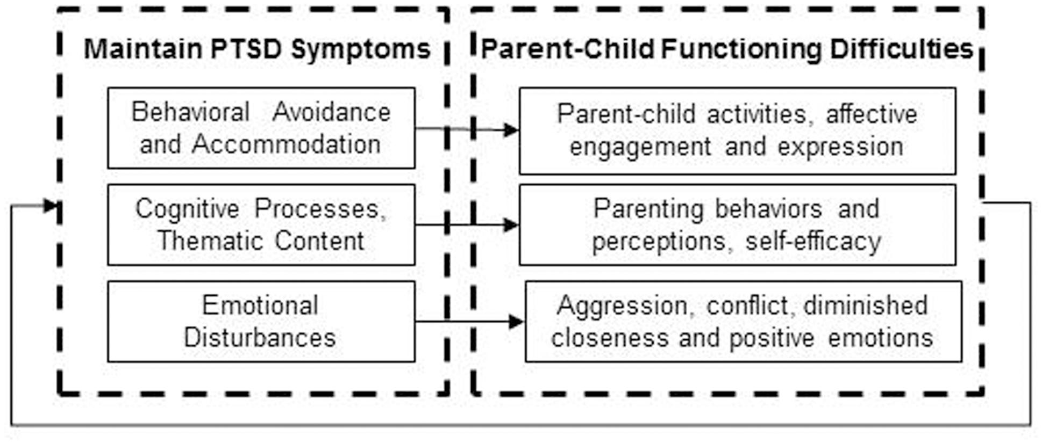
PTSD and the Effects on Families
Cognitive-Behavioral Interpersonal Theory (C-BIT) Applied to Parenting
Creech, S.K. & Misca, G. (2017)
Notes:
Discuss case examples
Divorce rates 70%
Remember Drill Sgt. Kids will say, “we’re not your Marines”

Slide 17
PTSD and the Effects on Children
“my parent doesn’t love me”
“Over-identified” child – mimic PTSD
“Rescuer” child – takes on adult role
“Emotionally uninvolved” – school problems, depression, anxiety, relationship problems later
Silencing – upsetting things are not to be talked about, “walking on eggshells”
Over-disclosure – exposure to graphic details of parents’ traumas
https://www.ptsd.va.gov/professional/treat/specific/parent_ptsd.asp
Notes:
Parents can be irritable, overprotective, easily startled, distant or hostile
Flashbacks/nightmares – frightening to children who witness them, confusing

Slide 18
Military Families & Resilience
Resilience = a product of the relationships between children and the people and resources around them
Strong sense of belonging to a supportive community with a shared mission and values.
Children whose parents are deployed may build their self-confidence by taking on new responsibilities in the family
Relocation offers opportunities for adventure and personal growth.
Easterbrooks, Ginsburg, Lerner (2013)
Notes:
As Tyler mentioned, there is concern for potential adverse outcome on the family system. I will be speaking about an active duty mother to illustrate this. However it is also important for us to acknowledge both sides of the coin. And by that I mean taking a look at resilience, strength, and what can be gained from the experience of bineg a child in a military family.
Resources = everyone here! You can help buffer stress of a deployment.
Service to country is a value that can be integrated early on. I here this from my adult Veterans whose parents served during other time periods.
New responsibilities – self-affirming positive feedback from parents and extended family.
Relocation – cultural awareness, unique memories, ‘cool kid’
Plug for the topic of posttraumatic growth – Children overcoming challenges benefitting from the growth
At the family level, children who encounter adversity need supportive and sensitive adults who are available physically, mentally, and emotionally. As we noted earlier, a supportive social network can buffer stress and foster resilience. Secure attachment relationships, for example, can mitigate the psychologi-
cal effects of natural disasters, community violence, and other serious stresses, such as extended separation from a deployed par- ent.27 In addition to providing a “haven of safety and stability”
self-affirming positive feedback from parents and extended family members for taking on additional responsibilities when
a parent is deployed.
families may help children see their experiences as a “badge of honor” rather than a burden.

Slide 19
Active Duty Families
Marriage
Service-member/Civilian
Service-member/Service-member
Service-member/Veteran
Incentives
Pay & housing allowance (18.2% more with dependents)
Divorce
Length and # of deployments
Women service-members (6.60% vs. 2.60%)
Southwell & Wadsworth (2016); Negrusa, Negrusa, Hosek, (2013)
Notes:
1. When we think about the family family constellation, there are different dynamics occurring. The major it of marriages are comprised of one service-member and one civilian, typically male to female respectively. Others are… and each provide their own unqiue challenges.
Not only on deployments but also with relocation. A term is used called “At the will of the Navy.”- you go where they tell you go go (e.g., Virginia or Japan…what would my wife say?”
Divorce stats – increase as a function of gender and deployment. Military members also marry and divorce at younger ages than the general population.

Slide 20
Single Parent Families
~36,000 (8%) single parents across all branches
Family care plans
Short-term care providers, long-term care providers, and care provision details.
Child care
Subsidized according to rank and marital status
DOD Directive 1332.14-1332.30
Notes:
Given the high divorce rates and age, an important group of servicemembers we should all be considering are single-parents.
Family care plan is a written document that guarantees there is someone local (non-military) who is on call 24hrs/day 7-days/week. This started after Desert Storm when there were hundreds of service-members who had no plans for their children. Now not having a family care plan will result in discharge.
160-200/week in private sector; Subsidized– pays 96/week at E5 pay; E3 pays 46/week

Slide 21
Single Mother - Navy Sailor
Obtaining childcare
“We basically need to figure it out ourselves and put the pieces together.”
“Get to know other single parents…share the responsibility.”
Effects on parent-child relationship
”When she was 1 year old, I had to go on the ship for 7-months. And when I got back, I had to be on watch (24 hour shift) every three days.”
”Some nights I didn’t want to call her and hear her cry.”
“Every time I dropped her off she said don’t leave me, am I going to see you?”
Notes:
Background: Mid to late 20s mother of a 4 year old receiving PTSD treatment for ‘complex trauma.’ Parenting was an important discussion in therapy because her hypervigilance about safety would be projected onto her child I n a sense.Ex. Went through 4-5 day cares, 3 calls per day to the childcare facilitity. When it comes to childcare, not only were we talking about the MH barriers related to trust, we were also trying to navigate the logistical issues like the family care plan. Read quotes.
Let’s also think about the dynamic with her daughter. Impact on attachment--> effects of maternal depression on child→ behavioral responses

Slide 22
Accessing treatment and supportive services
Notes:
Now let’s talk about how service-members and Veterans can access services

Slide 23
Active Duty (DoD)
Fleet & Family Support Center (FFSC)
Naval Medical Center San Diego (NMCSD) “Balboa”
32nd Street Base
Camp Pendleton
TriCare contracts
Sharp
Aurora
UCSD
Private practice
Notes:
1. FFSC - Individual counseling, Child counseling, Family counseling, Marriage/couple’s counseling, Domestic Abuse Victim Advocates, Family Advocacy Program (FAP) Services

Slide 24
Veteran (VHA)
VA San Diego Healthcare System (VASDHS)
Vast, robust, comprehensive services for all levels of care
Largest MH workforce in San Diego County (>400 FTE)?
38 Inpatient, 29 residential SUD, 40 domiciliary beds
Large outpatient programs for SUD, PTSD, SMI, Mood D/O
25,000 unique MH patients; 200,000 annual visits
But access is still poor: we send thousands to community care annually, wait times for most services >30 days, hundreds waiting who decline community care
No services for children or for spouses*
Notes:
* Caveat – couples therapy; spouse get support if they are deemed their official caregiver

Slide 25
Active Duty Family Interventions
Families Over Coming Under Stress Family Resilience Training (FOCUS PROJECT)
Evidence-based family-centered preventive interventions shown to improve psychological health and family functioning over longitudinal follow-up.
Associated with Improvements in parent and child mental health across time
Lester et al., (2016)
Notes:
1. In doing a literature review, I came across one robust DoD project called FOCUS. It is a a family-centered preventive service program designed to promote family resilience on military child emotional and behavioral outcomes. Partnership between UCLA and US Navy Buereau of Medicine & Surgery. Some of the elements include trauma-informed psychoeducation and skills training in the management of traumatic reactions and reminders; family resilience training to manage feelings, improve communication, and learn problem-solving and goal-setting skills. Typically 6-8 sessions. Also embeeded within FOCUS are couples services, early childhood evidencebd based interventions,

Slide 26
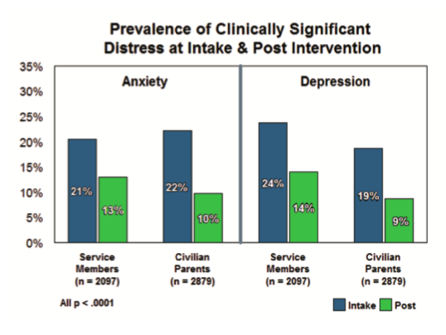
Notes:
1. Above is a graphical tool used for the partners to talk about their subjective experience of stress based upon contextual factors.
2. The data shows improvements in pro-social behavior at pre and post intervention for both boys and girls. These increases were statistically significant.
3. The last chart displays changes in anxiety and depression pre and post intervention. These changes were also statistically significant across both service-members and civilian parents.

Slide 27
Veteran Family Mental Health
Family Mental Health Program at VASDHS
Couples-based PTSD Telehealth Intervention
Vet Centers*
Stephen A. Cohen Military Family Clinic at Veterans Village of San Diego (VVSD)Cohen Veteran Network*
vvsd.net/cohenclinicsandiego
Notes:
While I am not aware of any sites implementing FOCUS itself, I can offer you several different referral options.

Slide 28
Cohen Veteran Network
High-quality mental healthcare services accessible to all post-9/11 (including National Guard and Reserves), their families, and the families of active duty service members including spouse or partner, children, parents, siblings, caregivers, and others
Depression
Anxiety
Post-traumatic stress disorder
Adjustment issues
Substance misuse
Anger
Grief and loss
Family issues
Transition challenges
Sleep problems
Relationship problems
Children’s behavioral problems
https://vvsd.net/cohenclinicsandiego/

Slide 29
Resources
DoD
VA
www.militarychildcare.com
www.focusproject.org
www.militaronesource.mil
www.sandiego.navylifesw.com
www.sandiego.va.gov
www.veterancrisisline.net
www.ptsd.va.gov
www.benefits.va.gov/sandiego/
www.vetcenter.va.gov

Slide 30
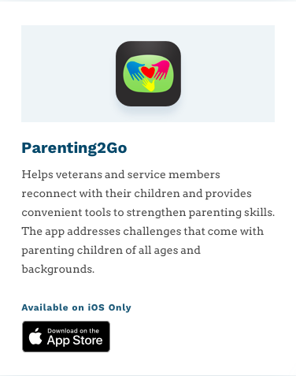
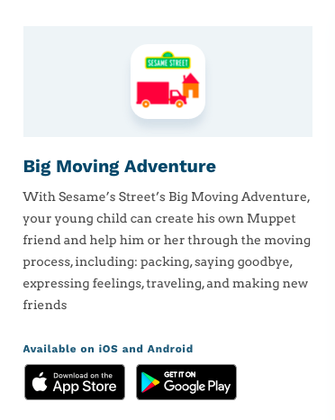
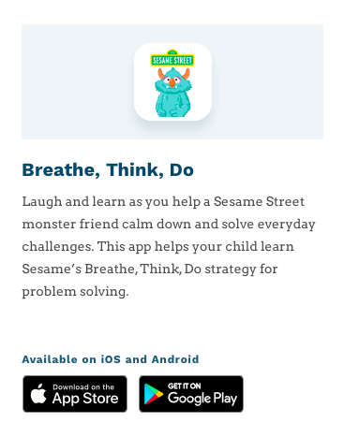
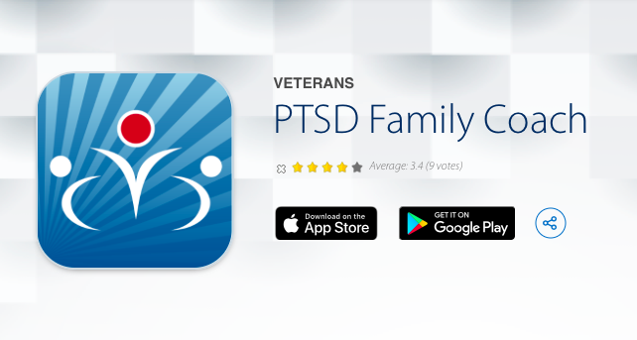
Mobile Apps
Mobile Apps

Slide 31
References
Beardslee WR, Lester P, Klosinski L, et al: Family-centered preventive intervention for military families: implications for implementation science. Prev Sci 2011; 12(4): 339–48.
Creech, S.K. & Misca, G. (2017). Parenting with PTSD: A review of Research on the Influence of PTSD on Parent-Child Functioning in Military and Veteran Families. Frontiers in Psychology.
Easterbrook, M., Ginsburg, K., Lerner, R., (2013).Resilience among military youth. The future of Children. 23, (2), 99-120.
Negrusa, S., Negrusa, B. & Hosek, J. Gone to war: have deployments increased divorces? (2014) J Popul Econ 27, 473–496 . https://doi.org/10.1007/s00148-013-0485-5
Hoge, C. W. (2010). Once a warrior, always a warrior: navigating the transition from combat to home--including combat stress, PTSD, and mTBI. Guilford, Conn.: GPP Life.
Lester, Patricia & Saltzman, William & Woodward, Kirsten & Glover, Dorie & Leskin, Gregory & Bursch, Brenda & Pynoos, Robert & Beardslee, William. (2012). Evaluation of a Family-Centered Prevention Intervention for Military Children and Families Facing Wartime Deployments. American journal of public health. 102 Suppl 1. S48-54. 10.2105/AJPH.2010.300088.

Slide 32
Cultural Competence w/ Veterans Recommended Readings:
National Center for PTSD: https://www.ptsd.va.gov/
VA: Community Provider Toolkit: www.mentalhealth.va.gov/communityproviders
Make the Connection: www.maketheconnection.net
DoD/VA: Center for Deployment Psychology: http://deploymentpsych.org/military-culture-course-modules
DoD: Defense Centers of Excellence for Psychological Health & Traumatic Brain Injury: http://dcoe.mil/Training/Education.aspx
After Deployment: http://afterdeployment.dcoe.mil/
PsychArmor Institute: http://www.psycharmor.org/#psycharmor
Head Space and Timing: http://veteranmentalhealth.com/
Task & Purpose Newsletter: http://taskandpurpose.com/
Have You Ever Served In the Military?: http://www.haveyoueverserved.com/
Wes MooreTED Talk: “How to talk to veterans about the war” https://www.ted.com/talks/wes_moore_how_to_talk_to_veterans_about_the_war?language=en
Sebastian Junger TED Talk: “Why Veterans Miss War” https://www.youtube.com/watch?v=TGZMSmcuiXM
Notes:
Movies and TV Shows: Seal Team, Full Metal Jacket, the Great Santini, Saving Private Ryan, Hurt Locker, Lone Survivor, American Sniper

